Slide 1


First steps with R in Life Sciences: Introduction
June 8-9, 2022
Leonore Wigger
-- with slides from Diana Marek, Leonore Wigger, Wandrille Duchemin

Slide 2
General Information
Course page: https://edu.sib.swiss/course/view.php?id=594
Course Material: Slides, Data Sets, Exercises
Feedback form (Thank you in advance!)
Google doc: Info + Q&A
Optional exam, 0.5 ECTS value
Notes:
This pad text is synchronized as you type, so that everyone viewing this page sees the same content. This allows you to collaborate together, share questions, pieces of code, chat ...Feel free to use it as much as you want. If you want to be identified, enter your name on the right side of the page.

Slide 3


Asking questions
Raise your hand anytime
Write into the Google Doc
(Include your name for personalized help)
Helpers are here to answer!
Notes:
This pad text is synchronized as you type, so that everyone viewing this page sees the same content. This allows you to collaborate together, share questions, pieces of code, chat ...Feel free to use it as much as you want. If you want to be identified, enter your name on the right side of the page.

Slide 4


Make use of the sticky notes
Yes/Done
No/Not Done
Notes:
With the teachers but NOT only
Ask if the audience know about the stickers. Explain the sticky note concept if necessary
You are doing active learning in your class when:
you ask a question, pose a problem, or issue some other type of challenge;
tell your students to work individually or in small groups to come up with a response; give them some time to do it;
stop them, and call on one or more individuals or groups to share their responses.

Slide 5
Introducing Ourselves
Notes:
This pad text is synchronized as you type, so that everyone viewing this page sees the same content. This allows you to collaborate together, share questions, pieces of code, chat ...Feel free to use it as much as you want. If you want to be identified, enter your name on the right side of the page.

Slide 6
Your experience:
3 quick polls

Slide 7
What type of computer OS are you using for this course?
Windows PC
Mac
Unix/Linux (Redhat, Ubuntu, etc)

Slide 8
Do you know other programming languages?
None
Yes, but I have only notions
Yes, I work regularly with at least one other language

Slide 9
What is your experience with R?
I’ve never tried to use R (apart from installing it).
I’ve tried to run a few commands or do a few exercises.
I’ve used R a little for work or personal projects.
I’ve used R extensively (wait, why am I even here?).

Slide 10

Course Content
R is vast and can't be learned overnight. The scope of this course:
basic understanding and concepts behind R
implement and interpret a data analysis workflow
This course is only the first step in
your journey
Notes:
NO STATS here
I will try to give u the tools to learn more (i.e. using R help, some book & online references, googling for the right answers)
What you don't know, you neighbor might know and vice et versa!

Slide 11
Outline
Day 1
01
What is R? Introduction
02
Getting familiar with R and the RStudio environment
03
Getting started with R syntax and objects
04
Formatting your data
05
Importing/exporting data with R
Notes:
2 coffee breaks – 1 lunch / day (en groupe at amphi)
Morning Getting ready to use R - What is R, why you should it? - R and R studio environments - Data management in your computer - Rstudio layout and components : console, script editor, working directory , R brain (workspace) , commenting, help, packages - R syntax and interacting with R Afternoon Import data in R - Getting data into R ( formatting it first) and out of R - Summarizing your data - Subsetting , aggregating it Morning Graphics in R - Graphical exploration (scatter plot, bar plot, hist...) - Graphics customisation - Permanent graphic changes, redirecting graphics to different devices Afternoon Statistical analysis in R - Hypothesis testing (t test, cor, chissq test/ fisher test) - Statistical models (linear regression, analyse of variance, multiple comparisons) BYOD (if it time allows)

Slide 12
Outline
Day 2
06
Building graphics in R (basic plotting)
07
Starting with statistics in R (hypothesis testing, simple linear regression)
Examples and exercises are integrated in the chapters
Notes:
Day 1 Morning Getting ready to use R - What is R, why you should it? - R and R studio environments - Data management in your computer - Rstudio layout and components : console, script editor, working directory , R brain (workspace) , commenting, help, packages - R syntax and interacting with R Afternoon Import data in R - Getting data into R ( formatting it first) and out of R - Summarizing your data - Subsetting , aggregating it Day 2 Morning Graphics in R - Graphical exploration (scatter plot, bar plot, hist...) - Graphics customisation - Permanent graphic changes, redirecting graphics to different devices Afternoon Statistical analysis in R - Hypothesis testing (t test, cor, chissq test/ fisher test) - Statistical models (linear regression, analyse of variance, multiple comparisons) BYOD (if it time allows)

Slide 13
What is R? Introduction
01

Slide 14
What is R?
R is a programming language and an environment for statistical computation and graphics.
A simple development environment with a console and a text editor
Facilities for data import, manipulation and storage
Functions for calculations on vectors and matrices
Large collections of data analysis tools
Graphical tools

Slide 15
Taking Advantage of R For Your Work
Tidying & data manipulation
Scientific question
Formatted Data In R
Data representation
Statistical analysis
communicate
Import in R
Exploration
Modelling
Export
Notes:
General workflow to take advantage of R for your work:
-specify your question very clearly.
Your Question, what hypothesis you're making, what data you will collect, coming from different type of experiment ( simulation study, field study, lab study, measurement machine ) – this will be your dataset(s)
-design your experiment very
well
-format your dataset nicely
Tidy step: checking some variables are of the correct type, manipulating the structure of the data
Explore in terms of graph, table, summary stats to get an idea of the answer(s)
Stats will give you a reliable Answer to confirm the question, confirming that the graphs gave you a reliable answer
Communicate answer, data, graphs to colleagues, boss: report, publication , summary – reproducible research and it is essential otherwise the previous steps were meaningless

Slide 16
R's success
R has become the tool of choice for statistical analysis in several fields, including life sciences.
Why?
It's free
It's well documented
Large number of contributed packages are freely available, easy to install, for nearly every type of statistics, machine learning, high-quality plots

Slide 17
R's user community
Group of core developers who maintain and upgrade the basic R installation. New version every 6 months.
Anyone can contribute with add-on packages which provide additional functionality (thousands of such packages available).
Online help
- in user group forums, eg:
https://stat.ethz.ch/mailman/listinfo/r-help
http://stackoverflow.com/questions/tagged/r
- in countless online tutorials, books, blogs
Notes:
New version every six months
Also an inconvenience! Especially for SysAdmins.

Slide 18
Getting familiar with R and RStudio environments
02

Slide 19
R installation
R can be freely downloaded, copied, used, modified or redistributed.
From the main website http://www.r-project.org choose "CRAN", "Download", then pick a mirror website close to you (e.g. in Switzerland).
You can then download and install the correct version for your operating system (Windows, Linux, Mac).
Notes:
Perhaps a word on the actual installation steps - even just to say that they're relatively straightforward and that the choices don't affect things much.

Slide 20

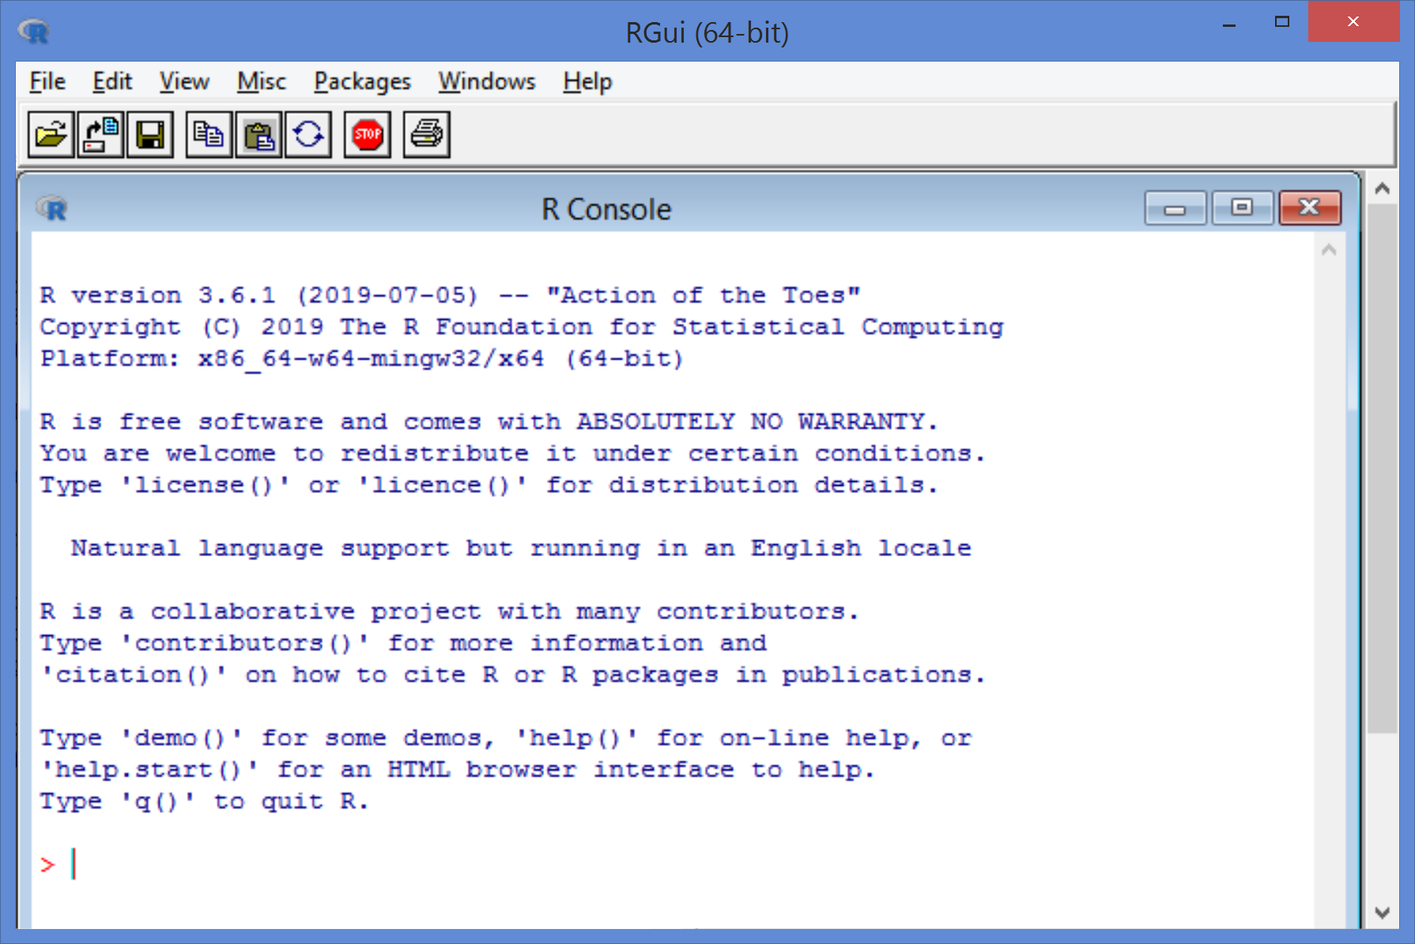
RGui (R Graphical user interface)
Together with the programming language, a graphical user interface is installed.

Slide 21
R Combined with RStudio
http://www.rstudio.com/
RStudio is an integrated development environment (IDE),
designed to help you be more productive with R
It includes:
A console
A syntax-highlighting editor that supports direct code execution
Tools for viewing the workspace and the history
A file explorer, a package explorer, plot and help display areas
We suggest Rstudio as a more powerful, more comfortable alternative to the RGUI
Notes:
Almost all what you will learn with R studio is applicable to R
Also
- a text file viewer/editor (i.e. on files other than .R) that can even be used to edit data (e.g. CSV) files,
- and a data frame viewer.

Slide 22
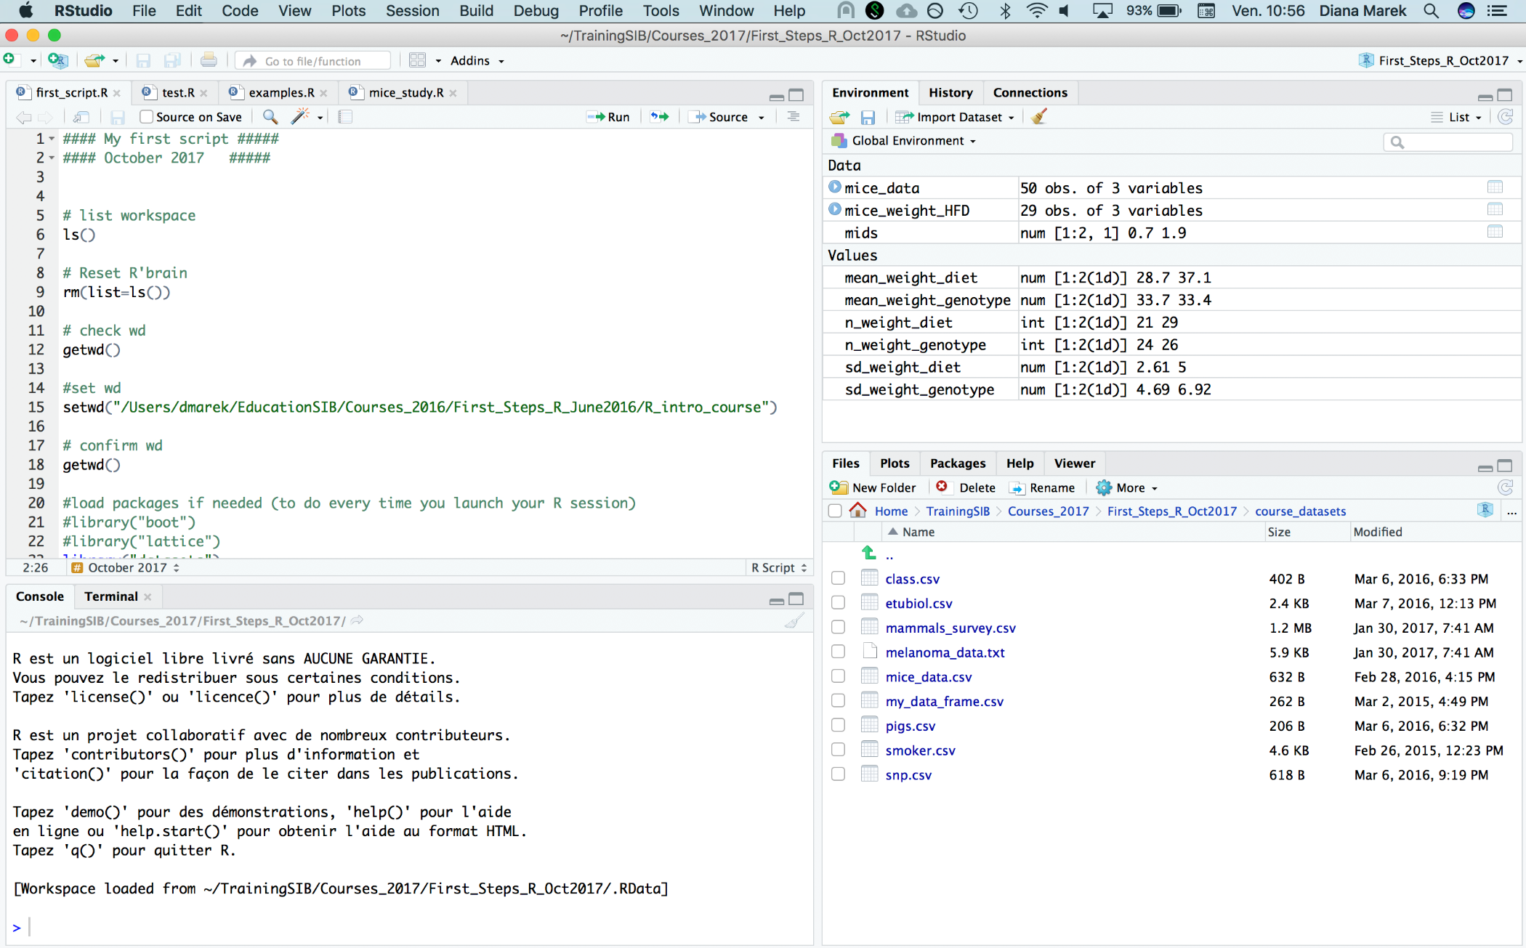
RStudio interface
Workspace, history
Editor
Console, terminal
File explorer, plots, packages, help
Notes:
Connections panel: RStudio 1.1 includes a new Connection wizard which makes it easy to connect to any data source on your system.

Slide 23
Creating an R Project
RStudio allows organizing your work into projects.
Go to File →New project or click on “Project” in the upper right corner of RStudio.
Choose New Directory, then New Project, give a name to the directory and set its location.
This creates a new directory which contains a .Rproj file (same name as the directory).
OR choose Existing Directory, click Browse, navigate to a folder, then click Create Project
This creates an .Rproj file inside the directory (same name as the directory).
The project directory becomes automatically the working directory.
This is one of the ways RStudio adds convenience
Notes:
Rstudio provides a way to save a lots of the files you're a working on all together in one packagee/project. A project is associated with a folder/directory
Start a project in a brand new working directory or an existing one (associate a project with an existing working directory)
The project name appear in the upper right art of the toolbar (active project)
The working directory becomes the directory of your project (try getwd()) : wd is the place where R will look for files to execute and where it will save files. By default R uses its own system directory.
You can open a new script and save it in the working directory
You can create variables in your script/console and save it
Then you can close your project (upper right part), by default it will ask you if you want to save you workspace into your working directory (default behaviour that can be changed)
Then you can go and have a look at your project folder on your HD and you will see you a .Rproj file
See on the terminal the hidden files
Then go back to your folder on your HD, double clik on the project, it will open the project (see uper right) and reopen the script, reload the variables and history
Project is a way to have all of those things together in a convenient format

Slide 24
Let’s practice – 1
1) Inside Rstudio: Project set-up
In RStudio, create a new project in a new directory named Rcourse2022.
2) Outside Rstudio: Prepare course data for exercises
Download course data sets (course_datasets.zip) from the course web site: https://edu.sib.swiss/course/view.php?id=594
Unzip into the newly created course directory.
Make sure the data files appear inside a sub-directory: course_datasets
Notes:
Works best when demonstrated live and students follow along rather than letting them try it by themselves.

Slide 25
Console: The Command Line
The prompt ">" indicates that R is waiting for you to type a command

Slide 26
After each command, hit the return key.
This causes R to execute it.

Slide 27
Try it out...
Type the following at the command prompt:
Simple calculations
> 1 + 1
Pre-defined functions
> abs(-11)
Assign values to a variable names
> x <- 128.5
Display content of variables
> x
After each command, hit the return key.

Slide 28
R Key Concepts
Variable: A storage space in memory that has a name and can hold data.
temp <- -5.5 # Create a variable named temp, holding value -5.5
Numeric constant: a number, such as 128.5
Character constant: a text sequence, such a "Hello" (enclosed in quotes)
Function: pre-written code that performs a specific task and can be executed by "calling" the function.
Write the function's name, followed by parentheses. Inside the parenthesis, pass variables or literal values to the function code (function arguments).
abs(temp) # the absolute value of temp
log2(16) # the base 2-logarithm of 16
q() # quit R (no function arguments necessary)
Operator: a special function for arithmetic, logical or other operations.
Examples of arithmetic operators: +, -, *, /, ^, …

Slide 29
Working Directory
R can read and write files. The working directory is the folder on your computer where it will look for files.
See the current working directory:
> getwd()
[1] "C:/Users/lwigger/Documents/Rcourse2022"
Change the working directory to any existing folder on your hard drive or system using setwd() and the file path, e.g.
> setwd("D:/R_exercises/")
In an Rstudio project, we usually do not need to change the working directory

Slide 30

Editor: Write Code to a File
Notice the syntax highlighting

Slide 31
R Scripts
A script is a file that contains commands to be executed in succession. Write your code into a script and save it
to have documentation later of what you did
to be able to re-use the code and create variations
for easy execution

Slide 32
Writing Scripts (.R file)
Create a new script using File → New File →R script. Don't forget to save your script often.
By default, scripts are saved into the working directory.
Files can be saved to other locations (File -> Save As…)
Notes:
You can open a new script and save it in the working directory
You can create variables in your script/console and save it
Advanced tip: To execute an entire file use the source() command from the console, with the script filename as argument or the Source button.
> source("myscript.r")
Note that by default the source() function does not print any results (can be modified changing the argument print.eval to "True") quite technical
In fact, due to this default absence of output printing (without explicit print() and cat() calls), issue that also arises when writing functions, I would avoid bringing too much attention to source() at this stage.
I personally reserve it for sourcing function definition files, rather than working scripts.

Slide 33
R scripts
Tips:
Most of your code should be developed and saved in scripts.
You can execute individual lines of code interactively while you are writing it.
You can run the entire script after it is finished and debugged.

Slide 34
Send Code From a Script to the Console
Run individual lines, one by one:
In RStudio: put the cursor anywhere in a line, hit
Ctrl + enter (Windows)
Cmd + return (Mac)
or click the "Run" button
Tip: Run part of a line or multiple lines: Highlight the code, then proceed as above

Slide 35
Workspace
The workspace is the internal memory where R stores the objects you created during the session.
Explore your workspace using the command line:
To list what is in your workspace, type
> ls()
To remove (delete) an object from the workspace, use function rm:
> rm(x)
To remove (delete) all objects from the workspace, type
> rm(list=ls())
Notes:
Svae Specific R objects (rather than the entire workspace) can be saved for later use using the save() command, separating the variable names by comma
The rm() function allows you to “remove objects from a specified environment”. In this case, you specify that you want to consider a list for this function, which is the outcome of the ls() function. This last function returns you a vector of character strings that gives the names of the objects in the specified environment. Since this function has no argument, it is assumed that you mean the data sets and functions that you as a user have defined.

Slide 36

Workspace in RStudio
Explore your workspace using Rstudio's GUI:
See the upper right quadrant, tab "Environment": all objects are listed
To remove all objects form the workspace, click the broom icon.
Notes:
Svae Specific R objects (rather than the entire workspace) can be saved for later use using the save() command, separating the variable names by comma
The rm() function allows you to “remove objects from a specified environment”. In this case, you specify that you want to consider a list for this function, which is the outcome of the ls() function. This last function returns you a vector of character strings that gives the names of the objects in the specified environment. Since this function has no argument, it is assumed that you mean the data sets and functions that you as a user have defined.

Slide 37
Let’s practice – 2
1) Prepare your first script
Open a script file and save it with file name "ex1.R"
Comment it (# symbol at the beginning of the line).
Type or paste the following code:
# First Steps, ex 1
w <- 3
h <- 0.5
area <- w * h
area
2) Look at the script (before trying to run it)
Can you understand each line? What do you expect it to print to the console?
3) Run the script and explore RStudio features
Run the script line by line. Try both the "Run" button and the keyboard shortcut. Watch variables appear in the Environment panel (top right).
Watch what is printed to the console (bottom left). Does it match your expectation?
Notes:
In online course:
Live demo
make the ex1.R available on a shared google doc so that they can copy it and play with it.

Slide 38
Closing or Switching Projects
Close a project:
File -> Close
Switch to another project, which will close the current one:
File -> Open Project...
Open another project and keep the current one open as well:
File -> Open Project in New Session...
Notes:
Workspace= The internal memory where R will store the objects you created during the session.
If you want to modify the general options of Rstudio , go to tools, global options

Slide 39
Reopening an R Project from a File
You can access your R project directly from your hard drive
Find the .Rproj file and open it (double click on many systems).
Rstudio will automatically start if it is not already running.
Notes:
Then you can go and have a look at your project folder on your HD an dyou will see you a .Rproj file
See on the terminal the hidden file
Then go back to your folder on your HD, doube clik on the project, it will open the project (see uper right) ans reopen the script, reload the variables and history
Not using project, have a look at the extra slides

Slide 40
Workspace (.Rdata) and History (.Rhistory) Options
When closing or switching projects, the workspace and the history are automatically cleared.
Your RStudio project can be configured to save your workspace and history to a file upon closing a project - or not.
Menu:
Tools –> Global Options –> General (set default for all projects)
Tools –> Project Options –> General (settings for one project)
CAUTION: .Rdata files can be very large.
Save only when you have space on your hard drive!
Notes:
Workspace= The internal memory where R will store the objects you created during the session.
If you want to modify the general options of Rstudio , go to tools, global options

Slide 41
Let’s practice – 2bis
4) Look at the project options (RStudio’s Tools menu). If needed, modify them to save your workspace and history and to restore them at startup.
Check if this works:
Close RStudio.
In your course folder, (double-)click the .rproj file.
Does your project open? Are your variables still in the Environment?
Check if this works, too:
Close RStudio.
Open RStudio again.
Verify that your project is currently closed. How do you see this?
From inside RStudio, open your project. Are your variables now in the Environment?
Notes:
Live demo, they can follow along

Slide 42
Saving the Workspace (.RData file)
Before quitting R, you have the option of saving everything that is currently in your workspace to a file.
To save your entire workspace, use save.image() and pass a file path of your choice as argument
> save.image("workspace_1.RData")
To save only specific R objects from the workspace, use save(), pass all objects you want to save and a file path of your choice
> save(x, y, my_sum, file="my_precious_objects.RData")
Notes:
Svae Specific R objects (rather than the entire workspace) can be saved for later use using the save() command, separating the variable names by comma
The rm() function allows you to “remove objects from a specified environment”. In this case, you specify that you want to consider a list for this function, which is the outcome of the ls() function. This last function returns you a vector of character strings that gives the names of the objects in the specified environment. Since this function has no argument, it is assumed that you mean the data sets and functions that you as a user have defined.

Slide 43
Saving the workspace (.RData file)
Before quitting R, you have the option of saving everything that is currently in your workspace to a file.
To save your entire workspace, use save.image() and pass a file path of your choice as argument
> save.image("workspace_1.RData")
To save only specific R objects from the workspace, use save(), pass all objects you want to save and a file path of your choice
> save(x, y, my_sum, file="my_precious_objects.RData")
.Rdata files are not human readable.
Notes:
Svae Specific R objects (rather than the entire workspace) can be saved for later use using the save() command, separating the variable names by comma
The rm() function allows you to “remove objects from a specified environment”. In this case, you specify that you want to consider a list for this function, which is the outcome of the ls() function. This last function returns you a vector of character strings that gives the names of the objects in the specified environment. Since this function has no argument, it is assumed that you mean the data sets and functions that you as a user have defined.

Slide 44
Loading a saved workspace (.RData file)
After re-starting R, you can load the workspace or the saved objects again.
Use load() with the path to the desired .Rdata file as argument
> load("workspace_1.RData")
Notes:
Svae Specific R objects (rather than the entire workspace) can be saved for later use using the save() command, separating the variable names by comma
The rm() function allows you to “remove objects from a specified environment”. In this case, you specify that you want to consider a list for this function, which is the outcome of the ls() function. This last function returns you a vector of character strings that gives the names of the objects in the specified environment. Since this function has no argument, it is assumed that you mean the data sets and functions that you as a user have defined.

Slide 45
Loading a saved the workspace (.RData file)
After re-starting R, you can load the workspace or the saved objects again.
Use load() with the path to the desired .Rdata file as argument
> load("workspace_1.RData")
.Rdata files are useful when
you want to start at the next session where you left off, without recalculating what you already did
you need to pass R objects to another person
Notes:
Svae Specific R objects (rather than the entire workspace) can be saved for later use using the save() command, separating the variable names by comma
The rm() function allows you to “remove objects from a specified environment”. In this case, you specify that you want to consider a list for this function, which is the outcome of the ls() function. This last function returns you a vector of character strings that gives the names of the objects in the specified environment. Since this function has no argument, it is assumed that you mean the data sets and functions that you as a user have defined.

Slide 46
Find help
R includes an extensive help system (like man in UNIX), which can be accessed directly from the command prompt.
Use help() or ? to display the help page for a function, operator or other element
> help(paste)
> ?paste
> help("^")
> ?"^"
Notes:
> help("*")
> ?"*" # Note : ?* is not valid.
There will typically be example usage, which you can test using the example function:
example(seq)
If you can't remember the exact name type ?? followed by your guess. R will return a list of possibles
> ??plot

Slide 47
Find help
R includes an extensive help system (like man in UNIX), which can be accessed directly from the command prompt.
Use help() or ? to display the help page for a function, operator or other element
> help(paste)
> ?paste
> help("^")
> ?"^"
Note: no quotes needed
Note: quotes required!
Single or double quotes will work
Notes:
> help("*")
> ?"*" # Note : ?* is not valid.
There will typically be example usage, which you can test using the example function:
example(seq)
If you can't remember the exact name type ?? followed by your guess. R will return a list of possibles
> ??plot

Slide 48
Find help
R includes an extensive help system (like man in UNIX), which can be accessed directly from the command prompt.
Use help() or ? to display the help page for a function, operator or other element
> help(paste)
> ?paste
> help("^")
> ?"^"
Note: no quotes needed
Note: quotes required!
Single or double quotes will work
Tip: Google is your friend, too!
Notes:
> help("*")
> ?"*" # Note : ?* is not valid.
There will typically be example usage, which you can test using the example function:
example(seq)
If you can't remember the exact name type ?? followed by your guess. R will return a list of possibles
> ??plot

Slide 49
Packages
Sets of related functions (and sometimes data sets)
A small number of packages are part of the basic R installation.
Many, many packages are developed by the user community and can be installed later as needed.
There are two main repositories that provide R packages of interest in the life sciences. Their content can be browsed on the web :
CRAN (Comprehensive R Archive Network, http://cran.r-project.org/) : the main R repository, with over 18600 packages (June 2022).
Bioconductor (http://www.bioconductor.org) : a separate project specialized in the analysis of high-throughput genomic and transcriptomic data, with 2040 packages (June 2022).
Notes:
And many other repositories
always first look if there is already an R package that does what you want before trying to implement it yourself
A word about installing packages on a Windows computer when non-admin (should be easy in practice with RStudio as it proposes the use of a personal library automatically).

Slide 50
Installing packages from CRAN
Install packages from CRAN with the install.packages() function
> install.packages("stringi") # character string manipulations
Installation necessary only once until you upgrade R to a new version.
Notes:
"Error: could not find function "xxxx" " – package has probably not been loaded.
Always document the output of sessionInfo() to record the versions of R + packages you used
Package vignettes (available on CRAN or Bioconductor)?

Slide 51
Loading functions from packages
Once a package is installed, its content needs to be made accessible to R.
library() loads the package for the current session.
It is good practice to load all needed packages at the top of a script.
# My Script
library(limma)
library(DESeq2)
library(MASS)
library(ggplot2)
# Here my data analysis begins
...
Notes:
"Error: could not find function "xxxx" " – package has probably not been loaded.
Always document the output of sessionInfo() to record the versions of R + packages you used
Package vignettes (available on CRAN or Bioconductor)?

Slide 52
Using functions from packages (II)
Alternative: If you need just one function from a package, you can run it without loading the package, using the operator ::.
stringi::stri_length("abc") # use the function stri_length
# from the package stringi
# without having run library(stringi)
Notes:
"Error: could not find function "xxxx" " – package has probably not been loaded.
Always document the output of sessionInfo() to record the versions of R + packages you used
Package vignettes (available on CRAN or Bioconductor)?

Slide 53
Session information
R.version.string prints the currently used R version.
sessionInfo() prints version information about R and attached or loaded packages.
Tip: Run sessionInfo() at the end of your data analysis and save the output.
This information is useful when you want to redo an analysis later, generate a report, or post a question on an online forum, …
Notes:
Always document the output of sessionInfo() to record the versions of R + packages you used

Slide 54
Working at the command prompt in RStudio
Shortcuts for both R console and RStudio:
TAB key for command auto completion.
Up and down arrows to scroll through the command history.
Ctrl-l to clear console window.
Shortcuts specific to Rstudio:
Ctrl-1 and Ctrl-2 to jump between the script and the console windows (shift focus).
Support for incomplete statements (R console and Rstudio):
If you hit return while your statement is incomplete, the command prompt (>) will change to +. R is waiting for you to finish writing it.
Keep typing and hit return again when done
OR hit “Esc” to abandon the unfinished command
Notes:
Ctrl-c does not work on mac but escape yes
You can copy-paste into the R console, but the Rstudio script editor allows you to 'send' the current line or the currently selected text to the R console using the Ctrl-Enter shortcut.
RStudio provides the Ctrl-1 and Ctrl-2 shortcuts allow you to jump between the script and the console windows.
It might not be obvious to first-time users that the console needs FOCUS to be typed into. Same for the script editor. The Ctrl-1/2 shortcuts highlight this, the Ctrl-Enter circumnavigates this. I would recommend mentioning the term FOCUS so that the participants can put a name on what they're actually doing.

Slide 55
In a Nutshell
R and RStudio environments
Use of R project to gather all documents related to a project together.
The working directory becomes the directory of your project.
Possibility to save/load workspace (.Rdata file) containing your objects.
Possibility to save/load history of commands (.Rhistory file).
Help and packages available.
More info on how to set up your R environment (if not using R projects) in the extra slides.
Now let's get familiar with R syntax and objects.

Slide 56
Getting started with R syntax and objects
03
Notes:
Essayer ces comandes

Slide 57
R Basic Data Types
Variables we have seen so far can hold one value. This value can be of different types. Use mode() to display it.
The three most common data types:
Numeric:
A number stored with decimal point. (Decimal point need not be displayed).
Examples: 0, 5, 55.2, -11.111
- in some contexts this data type is labeled "double“
- integers, stored without decimal points, exist but are rarely used.
Character:
A text sequence. Must be enclosed in quotes " ". (Single quotes work, too).
Examples: "1a++", "Hello World", "s", "99"
Logical:
TRUE or FALSE (This is binary. No other possible values).
Notes:
From a biologist/user viewpoint, a "variable" is most often going to be a vector - e.g. a standalone vector object, or a specific column in a dataframe or matrix.
Also, when using functions, from the function's viewpoint, objects passed to it are "arguments".
All in all, I would try and avoid confusion by calling R objects "objects" and restricting the use of the word "variable" to vector objects only.
Maybe insist on the difference between things stored in files and things stored in R's environment? Maybe later, when you can show them the files and the environment using RStudio???
Mean(x): the mean of the values stored in vector x, representing the measures for variable x.
These parentheses can be empty (as we have seen e.g. with the q() command), but they must be present for the function to be run (otherwise, the code of the function will be displayed).

Slide 58
R Syntax
Syntax refers to the spelling and "grammar" rules of a programming language.
A few important points :
Case sensitive: R differentiates between small letters and capitals.
Statements can be separated by a newline or by a semicolon ";" (for better readability, a newline after each statement is almost always preferable)
Long statements can be written on multiple lines
R has no strict rules about including or omitting blank spaces between elements, as long as the code is unambiguous. Make your spacing consistent and think of readability.
The # character stands for comments. Anything after a # on a line is ignored by R. Write comments into your code to explain what it does.
Notes:
#: HASHTAG
Note: Writing understandable and reusable code usually implies using long and clear variable names as well as adding enough comments to explain what is done.

Slide 59
R Objects
An object is a storage space that takes (or contains) a value, a data structure or a section of code.
All elements of an R statement can be thought of as objects.
Variables are objects containing data.
Functions are objects containing code.
Notes:
#: HASHTAG
Note: Writing understandable and reusable code usually implies using long and clear variable names as well as adding enough comments to explain what is done.

Slide 60
Allowed Names for Objects
Object names can consist of letters, numbers, dots and underscores.
Cannot start with a number.
Cannot contain operators (including hyphen).
Best to start with letter
Examples:
x
mydata1
mydata.normalized
n_times
Notes:
Otherwise you may overwrite the function! But in my experience this can only happen with user-defined functions. E.g. not an issue with "c" and "c()"

Slide 61
The Assignment Operator "<-" (or equivalent: "=")
We can use either the symbol "<-" or "=" to assign values to objects. Stick to one for consistency.
Create an object:
> x <- 10 # Create object x, assign the value 10 to it
# NB: This does the same as x = 10
Change the value of an existing object:
> x <- 25 # x has the value 10; overwrite it
Set one object to equal the value of another object:
> myNumber <- 15
> x <- myNumber # Both x and myNumber now contain 15
Modify the content of an object:
> x <- x + sqrt(16) # add the square root of 16 to x
Notes:
"x receives 10" and we ask R to print the content of the object x. The semi colon separator allows to write a sequences of commands into one line
Essayer ces comandes , les faire faire!

Slide 62
Using Functions (I)
Functions are called with parentheses () after the function name
Arguments are the input to functions, passed inside the ()
> ls() # no argument – list objects in workspace
> sqrt(81) # one argument – square root of the input
> rep(1,5) # two arguments – repeat the number 1 5 times
Arguments have names (specified in the function definition). Function calls can be made with unnamed or named arguments or a mix of both. Use "=" for named arguments.
> rep(x=1, times=5) # Named args. Equivalent to rep(1,5)
> rep(1, times=5) # Mixed. Equivalent to rep(1,5)
Check R help (?function_name) to see which arguments are expected by a function.
Notes:
sqrt(81): "apply function sqrt to the value 81"
Append TRUE = appending of the output to the file. Default FALSE

Slide 63
Using Functions (II)
Many functions take more than one argument
If unnamed, arguments must be listed in correct order (association by position).
If named, arguments can be passed in arbitrary order (association by name).
> write.table(object, "outfile.txt", TRUE)
> write.table(object, append=TRUE, file="outfile.txt")
Unnamed arguments: must appear in their correct position
Named arguments: their position does not matter
Notes:
sqrt(81): "apply function sqrt to the value 81"
Append TRUE = appending of the output to the file. Default FALSE

Slide 64
Using Functions (III)
Some functions have arguments with default values.
Example: function round()
Usage (from R Help): round(x, digits = 0)
Arguments with default values can be omitted in the function call; the default value is then used. Arguments without default values cannot be omitted.
> round(2.011) #rounding to 0 digits after decimal point
[1] 2 # (default value)
> round(2.011, 2) #rounding to 2 digits after decimal point
[1] 2.01
default value
Notes:
sqrt(81): "apply function sqrt to the value 81"
Append TRUE = appending of the output to the file. Default FALSE

Slide 65
Let’s practice – 3
For all exercises, feel free to use
- cheat sheets provided
- R help (? at command prompt)
Open a new script file and save it as ex3.R
Assign the values 6.7 and 56.3 to variables a and b, respectively.
2) Calculate (2*a)/b + (a*b) and assign the result to variable x. Display the content of x.
3) Find out how to compute the square root of variables. Compute the square roots of a and b and of the ratio a/b.
4) a) Calculate the logarithm to the base 2 of x (i.e., log₂ x).
b) Calculate the natural logarithm of x (i.e., log_{e} x).
Notes:
Don't forget to say that comments have to be added in front of the install.packages, library, save.image, load otherwise the compilation won't work.

Slide 66
Common Object Classes
vector – a series of data, all of the same type
matrix – multiple columns of same length, all must have the same type of data
data frame – multiple columns of same length, can be mix of data types
list – a collection of objects; can be of different classes and different sizes
function – a command to perform a specific task
Data objects
Function objects
Notes:
Array = matrix with different dimensions
Typeof(): determines the (R internal) type or storage mode of any object
Double
Integer
character

Slide 67
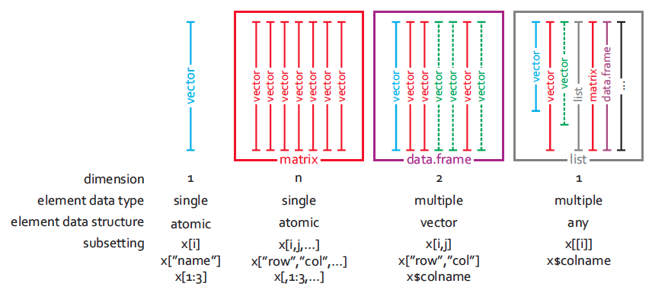
Graphical View on Data Object Classes
From M. Stadler
Notes:
Also arrays… 2D array is essentially same as matrix, 1D array essentially vector although maybe handled differently by certain packages

Slide 68
Creating Objects: Vectors
Vector: A series of data, all of the same type
Create a vector using c() # c() stands for concatenate
height_in_cm <- c(180, 167, 199)
Create a vector using c() where each element has a name
height_in_cm <- c(Mia=180, Paul=167, Ed=199)
Access elements of a vector using [ ]
height_in_cm[1] # get the first element
height_in_cm[c(1,3)] # get the 1st and 3rd element
height_in_cm["Paul"] # get the element named "Paul"
Scalars in R (the simple variables we have seen so far) can be thought of as vectors of length 1.
Notes:
Array = matrix with different dimensions
Typeof(): determines the (R internal) type or storage mode of any object
Double
Integer
character

Slide 69
Creating Objects: More Ways to Generate Vectors
Vectors of defined length with default value
> numeric(4); character(4); logical(4)
: (colon operator)
> a <- 1:10
seq() for sequences with any step size
> s <- seq(4,10,2) #start at 4, end at 10, step by 2
rep() for vectors with repeating elements
> genotypes <- c(rep("WT",3), rep("KO",3))
Use [] to extract repeated elements
> tplayer <- c("Federer", "Nadal")
> tplayer[c(1,1,1,2,2,1)] #3x Federer, 2x Nadal, 1x Federer
Notes:
Essayer ces comandes , les faire faire!
c stands for "concatenate"
someFactors <- as.factor(c(rep("WT",3), rep("KO",3)))
[1] WT WT WT KO KO KO
Levels: KO WT

Slide 70
Vector Manipulation (I)
Applying operators to vector results in element-wise operations
> a
[1] 1 2 3 4
> a * 2 # multiply each element of a by 2
[1] 2 4 6 8
> a + c(12,10,12,10) # add the elements in 2 vectors
[1] 13 12 15 14
Notes:
70

Slide 71
Vector Manipulation (II)
Many functions take a vector as argument.
Some perform an element-wise operation. Example:
> log2(a) # compute the logarithm in base 2 of each element
[1] 0.000000 1.000000 1.584963 2.000000
Some return a single value. Example:
> mean(a) # compute mean of the elements
[1] 2.5
Notes:
71

Slide 72
Coercion
All elements of a vector must be the same type
If combining different types, they will be coerced to the most flexible type
least to most flexible are: logical < numeric < character
Example:
> vec <- c(12, "twelve", TRUE) #combine 3 data types
> vec #all are coerced to character
[1] "12" "twelve" "TRUE"
> class(vec)
[1] "character"
Notes:
Otherwise you may overwrite the function! But in my experience this can only happen with user-defined functions. E.g. not an issue with "c" and "c()"
class(c(12,"twelve"))
[1] "character"

Slide 73
Coercion
We can coerce an existing vector to another type using the functions as.logical(), as.numeric(), as.character().
Example: Coerce a logical vector to numeric
Values are converted to 1 (for TRUE) and 0 (for FALSE)
we can use as.numeric() for explicit coercion
we can use mathematical functions on logical vectors, coercion to numeric happens automatically
> x <- c(FALSE, FALSE, TRUE)
> as.numeric(x)
> sum(x) # number that are true
> mean(x) # proportion that are true
Notes:
Otherwise you may overwrite the function! But in my experience this can only happen with user-defined functions. E.g. not an issue with "c" and "c()"
class(c(12,"twelve"))
[1] "character"

Slide 74
Factors
A factor is a vector containing values from a limited set; used for storing categorical data.
Example: Genotype of mouse individuals
> genotype <- factor(c("WT", "WT", "Mut2", "Mut1", "Mut2"))
The available values in a factor are called levels. Extract them:
> levels(genotype)
[1] "Mut1" "Mut2" "WT"
Convert the factor back to a character vector:
> geno <- as.character(genotype)

Slide 75
Factors with Custom Sorted Levels
By default, factor levels are sorted alphabetically.
We can specify a different sorting with the argument levels.
Example: Genotype of mouse individuals
> genotype <- factor(c("WT", "WT", "Mut2", "Mut1", "Mut2"),
levels = c("WT", "Mut1", "Mut2"))
> levels(genotype)
[1] "WT" "Mut1" "Mut2"
Levels are sorted the way we wanted

Slide 76
Factors from Numeric Vectors
Factors can be created from numeric data
Example: Birth year of children in a school class
> b_year <- factor(c(2011, 2012, 2012, 2011, 2010))
You must do two coercion steps to get numeric values back:
1. coerce the factor to character
2. coerce character to numeric
Example (with nested coercion functions):
> b_year_for_calc <- as.numeric(as.character(b_year))

Slide 77
Let’s practice - 4
1) Create two vectors, vector_a and vector_b, containing the values from −5 to 5 and from 10 down to 0, respectively.
2) Calculate the (element-wise) sum, difference and product between the elements of vector_a and vector_b.
3) a) Calculate the sum of elements in vector_a.
b) Calculate the overall sum of elements in both vector_a and vector_b.
4) Identify the smallest and the largest value among both vector_a and vector_b.
5) Compute the overall mean of the values among both vector_a and vector_b.
Hint: Each task in exercises 6-9 can be performed in a single statement per vector
Notes:
Don't forget to say that comments have to be added in front of the install.packages, library, save.image, load otherwise the compilation won't work.

Slide 78
Creating objects: Matrices
Matrix: multiple columns of same length, all must have the same type of data
Create a matrix
matrix(): start from a vector and reshape it
> mat <- matrix(1:12, nrow=3, ncol=4) # 3x4 matrix
cbind(): bind columns together
> mat1 <- cbind(c(1,0), c(0,1), c(1,0)) # 2x3 matrix
rbind(): bind rows together
> mat2 <- rbind(c(1,0), c(0,1), c(1,0) # 3x2 matrix

Slide 79
Operators (Most Commonly Used Ones)
Arithmetic
+, -, *, /, ^
Comparison
>, <, <=, >=, == (equal to), != (not equal to)
Logical
! (negation), & (AND), | (OR)
Other
%in% (in operator)
Comparisons, logical operators and %in% always return logical values! (TRUE, FALSE)
Notes:
!: It is called Logical NOT operator. Takes each element of the vector and gives the opposite logical value.
& and l operators are element Element-wise Logical operators. It combines each element of the first vector with the corresponding element of the second vector
The logical operator && and || considers only the first element of the vectors and give a vector of single element as output.
%in%: This operator is used to identify if an element belongs to a vector.
The shorter form performs elementwise comparisons in much the same way as arithmetic operators. The longer form evaluates left to right examining only the first element of each vector. Evaluation proceeds only until the result is determined. The longer form is appropriate for programming control-flow and typically preferred in if clauses.
Further details and related logical operations can be found in the R documentation.
> help("&")

Slide 80
Operators returning logical values: examples
> c(1,3,2) == 2
[1] FALSE FALSE TRUE
> !c(1,3,2) < 2
[1] FALSE TRUE TRUE
> table(!c(1,3,2) < 2)
#FALSE TRUE
#2 1
> c("Fred", "Marc", "Dan", "Ali") %in%
c("Dan", "Geoff", "Ali")
[1] FALSE FALSE TRUE TRUE
Notes:
table(!c(1,3,5,1,2,2,1)<2 ): creates a table of counts for Trues and Falses`
%in% is a more intuitive interface as a binary operator, which returns a logical vector indicating if there is a match or not for its left operand.

Slide 81
Missing Values
R distinguishes between
NA (not available)
NaN (not a number, e.g. result of 0/0)
Use the functions is.na() and is.nan() to detect them.
Notes:
Missing values are designated with the special NA value. By default, most operations on NA values return NA , but this behaviour can usually be changed by setting a parameter. The is.na() function indicates where NA values are located in a vector.
The data frame contains some 'NA' values, which means the values are missing – a common occurrence in real data collection.
• NA is a special value that can be present in objects of any type (logical, character, numeric etc).
• NA is not the same as NULL. NULL is an empty R object. NA is one missing value within an R object (like a data frame or a vector).
• Often R functions will handle NAs gracefully, but sometimes we have to tell the functions what to do with them. R has some built-in functions for dealing with NAs, and functions often have their own arguments (like na.rm) for handling them.

Slide 82
Missing Values
R distinguishes between
NA (not available)
NaN (not a number, e.g. result of 0/0) and
Inf (Infinity, result of division by 0)
Use the functions is.na() and is.nan() to detect them.
Notes:
Missing values are designated with the special NA value. By default, most operations on NA values return NA , but this behaviour can usually be changed by setting a parameter. The is.na() function indicates where NA values are located in a vector.
The data frame contains some 'NA' values, which means the values are missing – a common occurrence in real data collection.
• NA is a special value that can be present in objects of any type (logical, character, numeric etc).
• NA is not the same as NULL. NULL is an empty R object. NA is one missing value within an R object (like a data frame or a vector).
• Often R functions will handle NAs gracefully, but sometimes we have to tell the functions what to do with them. R has some built-in functions for dealing with NAs, and functions often have their own arguments (like na.rm) for handling them.

Slide 83
Missing Values: Examples (I) NA
Missing values are usually represented by NA:
> y <- c(1,2,3,4,5,NA,NA)
NA's interfer with many functions:
> mean(y)
[1] NA
Arguments often exist to remove NA's before calculation
> mean(y, na.rm=TRUE)
[1] 3
Alternatively, use na.omit() to remove NAs from the data
> y_cleaned <- na.omit(y)
> mean(y_cleaned)
[1] 3
Notes:
Missing values are designated with the special NA value. By default, most operations on NA values return NA , but this behaviour can usually be changed by setting a parameter. The is.na() function indicates where NA values are located in a vector.
The data frame contains some 'NA' values, which means the values are missing – a common occurrence in real data collection.
• NA is a special value that can be present in objects of any type (logical, character, numeric etc).
• NA is not the same as NULL. NULL is an empty R object. NA is one missing value within an R object (like a data frame or a vector).
• Often R functions will handle NAs gracefully, but sometimes we have to tell the functions what to do with them. R has some built-in functions for dealing with NAs, and functions often have their own arguments (like na.rm) for handling them.

Slide 84
Missing Values: Examples (II)
> x <- c(1, NA, 0/0) ; x # a vector to play with
[1] 1 NA NaN
> is.na(x) #detects NAs and NaNs from x
[1] FALSE TRUE TRUE
> is.nan(x) # detects only NaNs from x
[1] FALSE FALSE TRUE
> x > 2 # what if we try to compare NA and NaN to a number?
[1] FALSE NA NA
> x[!is.na(x)] # removes NAs and NaNs from x
[1] 1
Notes:
Missing values are designated with the special NA value. By default, most operations on NA values return NA , but this behaviour can usually be changed by setting a parameter. The is.na() function indicates where NA values are located in a vector.
The data frame contains some 'NA' values, which means the values are missing – a common occurrence in real data collection.
• NA is a special value that can be present in objects of any type (logical, character, numeric etc).
• NA is not the same as NULL. NULL is an empty R object. NA is one missing value within an R object (like a data frame or a vector).
• Often R functions will handle NAs gracefully, but sometimes we have to tell the functions what to do with them. R has some built-in functions for dealing with NAs, and functions often have their own arguments (like na.rm) for handling them.

Slide 85
Missing Values: Examples (III)
> z <- 33/0 # division by 0 results in Infinity
> z
[1] Inf
> is.na(z) # Infinity is not a missing value
[1] FALSE
Notes:
Missing values are designated with the special NA value. By default, most operations on NA values return NA , but this behaviour can usually be changed by setting a parameter. The is.na() function indicates where NA values are located in a vector.
The data frame contains some 'NA' values, which means the values are missing – a common occurrence in real data collection.
• NA is a special value that can be present in objects of any type (logical, character, numeric etc).
• NA is not the same as NULL. NULL is an empty R object. NA is one missing value within an R object (like a data frame or a vector).
• Often R functions will handle NAs gracefully, but sometimes we have to tell the functions what to do with them. R has some built-in functions for dealing with NAs, and functions often have their own arguments (like na.rm) for handling them.

Slide 86
Creating Objects: Data Frames
data frame: multiple columns of same length, can be mix of data types
>name <- c("Joyce", "Chaucer", "Homer")
>status <- c("dead", "deader", "deadest")
>reader_rating <- c(55, 22, 100)
Create a data frame using the function data.frame()
>poets <- data.frame(name, status, reader_rating)
>poets
name status reader_rating
1 Joyce dead 55
2 Chaucer deader 22 3 Homer deadest 100

Slide 87
Creating Objects: Lists
List: a collection of objects; can be of different classes and different sizes
Create a few objects:
> vec <- c(0.4, 0.9, 0.6)
> mat <- cbind(c(1,1), c(2,1))
> df <- data.frame(name=c("Ed", "Lisa"), age=c(61, 71))
Unnamed list - collect these objects in a list, using the function list():
> l <- list(vec, mat, df)
Named list - collect these objects in a list with named elements:
> l_with_names <- list(myvector=vec, mymatrix=mat, mydata=df)

Slide 88
Detecting Data Types and Object Classes
The function class() is useful when we are not sure what kind of object we are dealing with.
for vectors, returns the basic data type of its elements ("numeric", "character", "logical", …)
similar to mode() but slightly more fine-grained
- recognizes "integer" as different from "numeric"
- recognizes factors (categorical variables)
for all other objects covered on previous slide, returns their class ("matrix", "data.frame", "list", "function", ...)
Notes:
Array = matrix with different dimensions
Typeof(): determines the (R internal) type or storage mode of any object
Double
Integer
character

Slide 89
Accessing Data Elements
matrix:
>m[2, 2] # gets the element on row 2 in column 2
>m[1:3, ] # gets rows 1,2,3
>m[, c(1,4)] # gets columns 1 and 4
data frame:
>poets[2, 2] # gets the element on row 2 in column 2
>poets[, c(1,3)] # gets columns 1 and 3
>poets[, c("name", "reader_rating")] # gets columns "name"
# and "reader_rating"
>poets$name # gets column "name"
list:
>l[[1]] # gets the first object
>l_with_names[["myvec"]]# gets the object named "myvec"
>l_with_names$myvec # gets the object named "myvec", too

Slide 90
Accessing Names of Data Elements
matrix and data frame:
>rownames(poets) # gets the row names
>colnames(poets) # gets the column names
>rownames(poets) <- c("J", "C", "H") # overwrites row names
list:
>names(l_with_names) # gets the list elements' names
>names(l_with_names) <- c("A", "B", "C") # overwrites names

Slide 91
Let’s practice – 5
Open a new script and save it as "Ex5.R". Comment it.
In your script, write commands to install and load the package "MASS".
Write a command to load the bacteria data set from the package MASS:
data(bacteria) # loads the bacteria data set (from MASS)
Execute the command. Check: You should have a variable named "bacteria" in your Environment.
3) What are the names of the columns of the bacteria data.frame ?
4) Use [] to select rows 100 to 119 of the column “ap” .
5) Use $ to get the column "week" and check how many missing values it has.
Optional : 6) Count how many rows correspond to a “placebo” treatment (“trt” column) using the comparison operator "==".
Notes:
Don't forget to say that comments have to be added in front of the install.packages, library, save.image, load otherwise the compilation won't work.

Slide 92
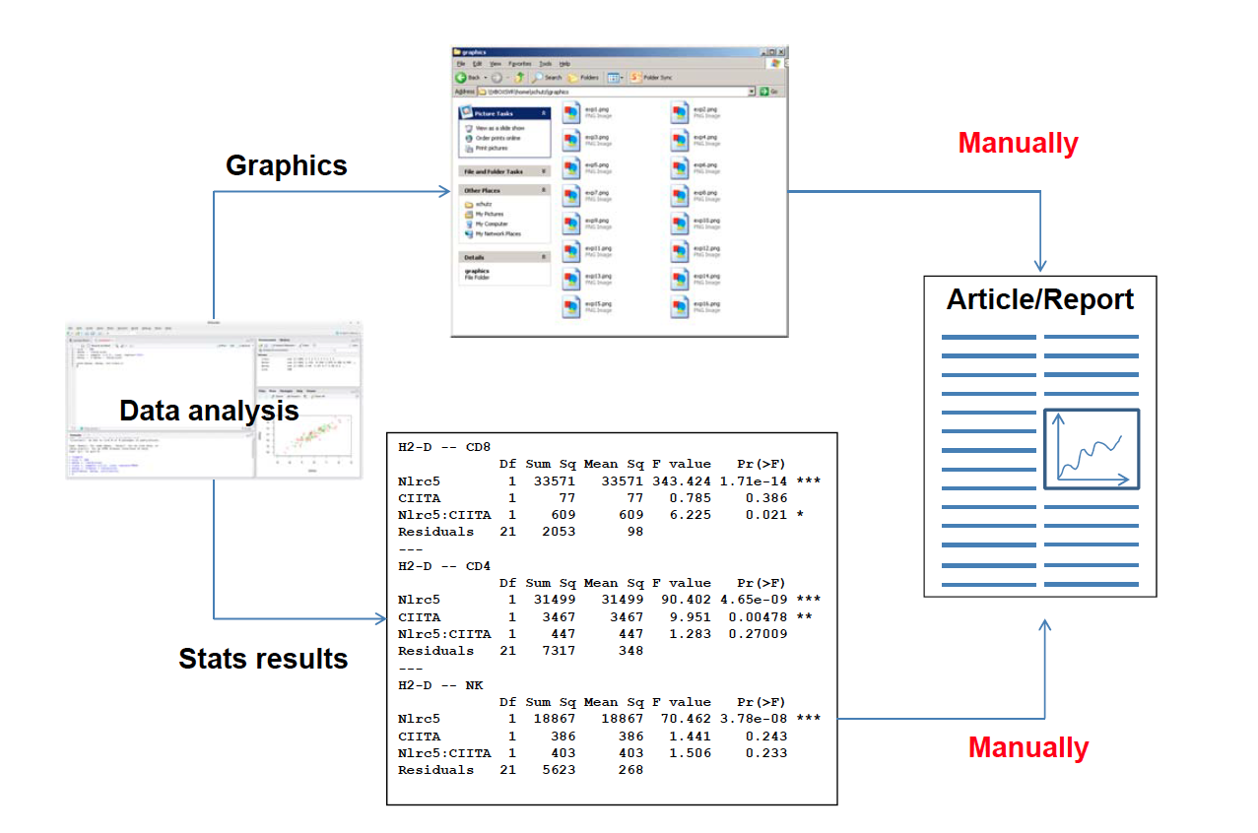
Dynamic report generation
Courtesy of Frédéric Schütz
Notes:
We know we will make mistakes … We must be able to track what we have done, so we can later find mistakes and correct them (reproducible research)
Dynamic report generation with knitR and R markdown is a good thing

Slide 93
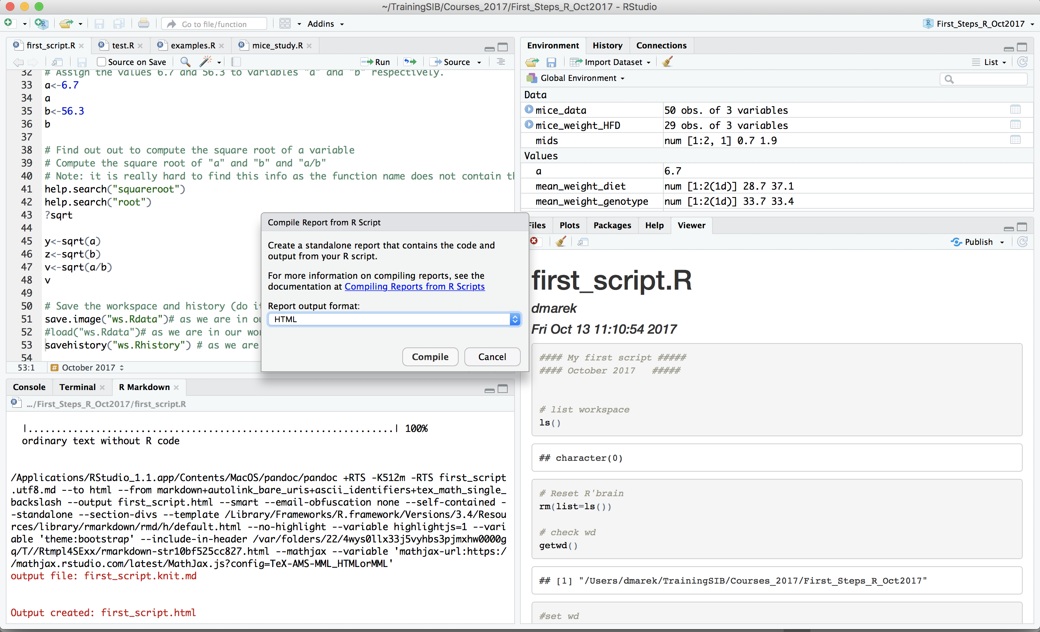
Compile reports from R script
A report is a standalone document that contains the code and the output from your R script.
Different output formats: pdf, html, doc
Go to File -> Compile Reports …
Notes:
Why ?
Combine program code and explanation/documentation in same document
Documents in which the information is always upto-date
Writing report step by step while processing thedata, in the same file
https://support.rstudio.com/hc/en-us/articles/200552276-Creating-Notebooks-from-R-Scripts
R Markdown provides an easy way to generate reports that include analysis, code, and results. However, if your code is in an R script rather than an R Markdown document you can still generate a report using the Compile Notebook command:
You don’t necessary need to author an R Markdown document to create a dynamic report. In fact, you can take any R script and compile it into a report that includes commentary, source code, and script output. Reports can be compiled to any output format including HTML, PDF, MS Word, and Markdown.
Compiling a notebook for an R script automatically generates an R Markdown document, executes it, and then writes the results as a standalone HTML. pdf, or MS Word file. You'll find the Compile Notebook command for R scripts both on the File menu as well as on the source editor toolbar.
Any images included in the HTML file are embedded, so the document can be easily distributed as standalone file.
library('rmarkdown')
rmarkdown::render('/Users/you/Documents/yourscript.R')

Slide 94
In a Nutshell
Everything in R is an object.
Using R is all about creating and manipulating data objects using functions (which are themselves objects).
Objects can be assigned to a name
Objects have a class (data frame, matrix, list etc)
Data values inside objects have different data storage modes (numeric, character, logical)
We covered many ways to generate data (create objects).
Now, let's import some data !

Slide 95
Taking advantage of R for your work
Scientific question
Formatted Data In R
Data representation
Statistical analysis
Communicate
Tidying & data manipulation
Import in R
Exploration
Modelling
Export
Notes:
General workflow to take advantage of R for your work:
-specify your question very clearly.
Your Question, what hypothesis you're making, what data you will collect, coming from different type of experiment ( simulation study, field study, lab study, measurement machine ) – this will be your dataset(s)
-design your experiment very well
-format your dataset nicely
Tidy step: checking some variables are of the correct type, manipulating the structure of the data
Explore in terms of graph, table, summary stats to get an idea of the answer(s)
Stats will give you a reliable Answer to confirm the question, confirming that the graphs gave you a reliable answer
Communicate answer, data, graphs to colleagues, boss: report, publication , summary – reproducible research and it is essential otherwise the previous steps were meaningless

Slide 96
Taking advantage of R for your work
Scientific question
Formatted Data In R
Data representation
Statistical analysis
Communicate
Tidying & data manipulation
Import in R
Exploration
Modelling
Export
Notes:
General workflow to take advantage of R for your work:
-specify your question very clearly.
Your Question, what hypothesis you're making, what data you will collect, coming from different type of experiment ( simulation study, field study, lab study, measurement machine ) – this will be your dataset(s)
-design your experiment very
well
-format your dataset nicely
Tidy step: checking some variables are of the correct type, manipulating the structure of the data
Explore in terms of graph, table, summary stats to get an idea of the answer(s)
Stats will give you a reliable Answer to confirm the question, confirming that the graphs gave you a reliable answer
Communicate answer, data, graphs to colleagues, boss: report, publication , summary – reproducible research and it is essential otherwise the previous steps were meaningless

Slide 97
Formatting Your Data
04

Slide 98
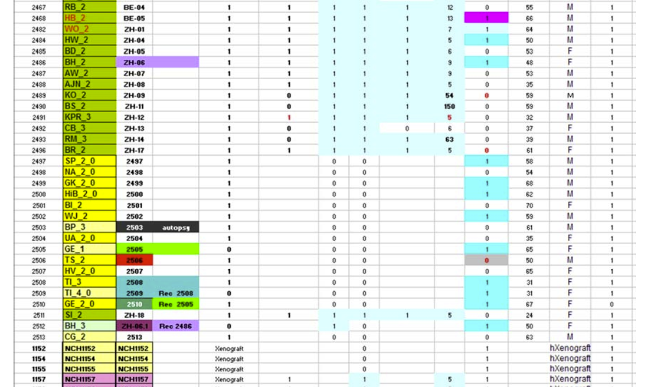
Example of a dataset
Difficult to use with any statistical program
Courtesy of Frédéric Schütz
Notes:
Column headers are values, not variable names.
Multiple variables are stored in one column.
Variables are stored in both rows and columns.
Multiple types of observational units are stored in the same table.
A single observational unit is stored in multiple tables.

Slide 99
Prepare Your Data Outside of R
Before using R and importing the dataset you collected from an experiment, you need to know how to format it properly, so R can read it.
A spreadsheet program such as Excel or OpenOffice can be used for data entry and simple manipulation.
Three precepts of tidy data:
Each variable forms a column.
Each observation forms a row.
Each type of observational unit forms a table.
http://www.ucd.ie/ecomodel/pdf/TidyData.pdf
Notes:
Real datasets can, and often do, violate the three precepts of tidy data in almost every way imaginable.
While occasionally you do get a dataset that you can start analysing immediately, this is the exception, not the rule. This section describes the five most common problems with messy datasets, along with their remedies:
Column headers are values, not variable names.
Multiple variables are stored in one column.
Variables are stored in both rows and columns.
Multiple types of observational units are stored in the same table.
A single observational unit is stored in multiple tables.
When tidying your data you should ensure that:
each variable has its own column
each row is an observation
the top of each column contains the name of the variable
there are no blank columns or blank rows between data
all data in a column has the same type (e.g. it is all numerical data, or it is all text data)
data are consistent (e.g. if a binary variable can take values ‘Yes’ or ‘No’ then only these two values are allowed, with no alternatives such as ‘Y’ and ‘N’)

Slide 100
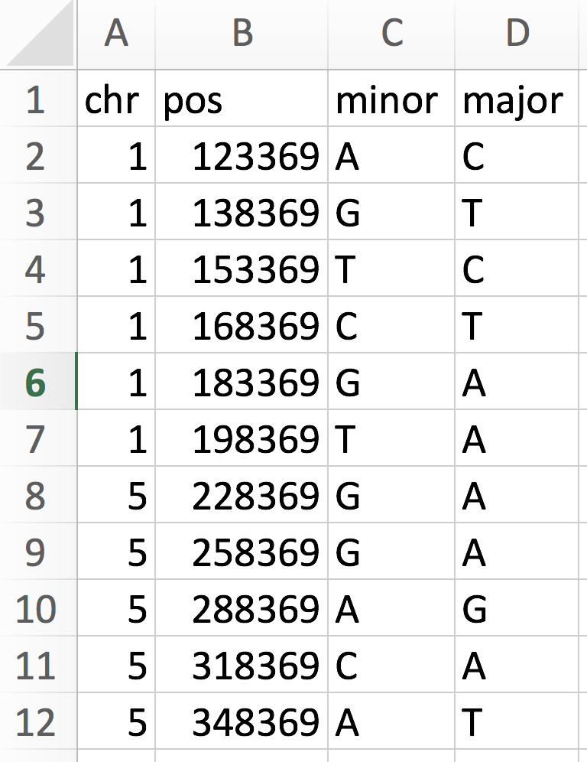
Example of Well-Formatted Dataset
A header line with variable names
4 variables, one in each column
One observation per row, here SNP info
Notes:
Following checklist that will make it easier to import the data correctly into R:
If you work with spreadsheets, the first row is usually reserved for the header, while the first column is used to identify the sampling unit;
Avoid names, values or fields with blank spaces, otherwise each word will be interpreted as a separate variable, resulting in errors that are related to the number of elements per line in your data set;
If you want to concatenate words, inserting a . in between to words instead of a space;
Short names are prefered over longer names;
Try to avoid using names that contain symbols such as ?, $,%, ^, &, *, (, ),-,#, ?,,,<,>, /, |, \, [ ,] ,{, and };
Delete any comments that you have made in your Excel file to avoid extra columns or NA's to be added to your file; and
Make sure that any missing values in your data set are indicated with NA.

Slide 101
Example of Well-Formatted Dataset
Glossary for the snp data
snp single nucleotide polymorphism
chr chromosome
pos position
minor minor allele (a minority of individuals
have this letter at this position)
major major allele ( a majority of individuals
have this letter at this position)
Notes:
Following checklist that will make it easier to import the data correctly into R:
If you work with spreadsheets, the first row is usually reserved for the header, while the first column is used to identify the sampling unit;
Avoid names, values or fields with blank spaces, otherwise each word will be interpreted as a separate variable, resulting in errors that are related to the number of elements per line in your data set;
If you want to concatenate words, inserting a . in between to words instead of a space;
Short names are prefered over longer names;
Try to avoid using names that contain symbols such as ?, $,%, ^, &, *, (, ),-,#, ?,,,<,>, /, |, \, [ ,] ,{, and };
Delete any comments that you have made in your Excel file to avoid extra columns or NA's to be added to your file; and
Make sure that any missing values in your data set are indicated with NA.

Slide 102
Formatting Recommendations – Checklist
If you work with spreadsheets, the first row is usually reserved for the header.
The first column may or may not be an ID column.
Remove blank spaces from column names and in fields. If you want to concatenate words, insert a "." or "_" between words.
Avoid column names containing symbols other than "." and "_".
Short names are preferred over longer names.
Delete any comments or other content in the spreadsheet that are not part of the data table but are above, below or beside the data table.
Make sure that any missing values in your data set are indicated with NA. (Check spelling! N.A. or n.a. does not work.)
Notes:
Following checklist that will make it easier to import the data correctly into R:

Slide 103
Other Recommendations
If you’re using a spreadsheet, keep a copy of the original data as it was provided to you. Prepare a new, "cleaned" version for your data analysis.
Do not include columns that you do not need for your analysis.
Have data backups!

Slide 104
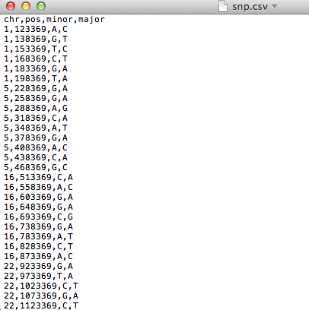
Saving Your Data
Export the spreadsheet to your computer in a text file format:
csv (comma separated values) format, with file extension .csv OR
tsv (tab separated values) format, with file extension .txt or .tsv
Now you are ready to start with the analysis

Slide 105
Keep your data save:
Have a back up!

Slide 106
Importing/exporting data into R
05

Slide 107
Importing Data
Most widely used R base function for data import: read.table()
reads a formatted text file
imports it as a data frame
many options, to accommodate most text files (e.g., csv, tsv).
To read an entire data frame from a file, it should have:
a header line containing the names of all variables
(not obligatory but preferable)
one line per row, with values for each variable
(missing values should be indicated using NA)
Items must be separated by the same separator symbol
(most common: , ; \t )
Notes:
which reads formatted text files (by default from your current working directory)
Very important point: it is possible to export *properly-prepared* Excel sheets to such text file formats (e.g. CSV)
Warning about commas, semi-colons, single and double quotes in text fields in CSV files

Slide 108
Importing Data – Two Questions
Where is the file I want to import?
Look for your file in the file system.
Note its path: the succession of folders to access it
Where is my working directory?
use getwd() (recommendation: should be the project directory)
Notes:
which reads formatted text files (by default from your current working directory)
Very important point: it is possible to export *properly-prepared* Excel sheets to such text file formats (e.g. CSV)
Warning about commas, semi-colons, single and double quotes in text fields in CSV files

Slide 109
File paths can be specified as a string with '/' as separator:
"C:/Users/Leo/courses/data/snp.csv"
Or with a little help from the function file.path():
file.path("C:", "Users", "Leo", "courses", "data", "snp.csv")
File Paths in R
WARNINGS:
On Windows : replace ‘\’ by ‘/’

Slide 110
R understands "." and ".." for relative file paths
. is the current directory (=working directory)
.. is the parent directory
"./data/snp.csv" # file "snps.csv" in subfolder "data" of current directory
"../../snp.csv" # file "snps.csv", 2 levels up from current directory
Also works with file.path():
file.path("..", "..", "snp.csv")
File Paths in R - Relative

Slide 111
Importing Data – File Paths
read.table() needs to know where the file is located.
Data file is in the working directory: file name suffices.
read.csv("snp.csv“)
Data file is in a sub-folder of working directory: It's easy to use a relative path. (Great option for projects shared with others).
read.csv("data/snp.csv“) or
read.csv(file.path("data", "snp.csv"))
Data file is somewhere else or you are not working inside a project: it's safest to use an absolute path (but can be more painful to specify!).
read.csv("C:/Users/Leo/courses/data/snp.csv”)
Notes:
which reads formatted text files (by default from your current working directory)
Very important point: it is possible to export *properly-prepared* Excel sheets to such text file formats (e.g. CSV)
Warning about commas, semi-colons, single and double quotes in text fields in CSV files

Slide 112
The file can be imported as a data frame using the functions read.table() or read.csv()
Use read.table()
> snps <- read.table("snp.csv", header=TRUE, sep=",") # we need to supply certain arguments
Use read.csv()
> snps <- read.csv("snp.csv") # arguments can be omitted since defaults are adapted to reading .csv
Notes:
You can try to load the same file or You can also use your own data if you have some

Slide 113
Importing Data
Important optional arguments of read.table(), read.csv(), read.delim()
header (TRUE/FALSE): specifies whether the first line contains column names
Default in read.table() is FALSE.
Default in read.csv() and read.delim() is TRUE.
sep: specifies the field separator character (e.g. "," or tab "\t").
Default in read.table() is any white space characters (space, tab, newline and carriage return).
Default in read.csv() is comma. Default in read.delim() is tab.
colClasses: manually setting each variable data type
When in doubt, use help(read.table)
Notes:
Mention "na.strings" arguments, even if not detailed? Same for "row.names", "eol"...
113

Slide 114
Checking the Imported Data
It is very important to check that data you asked R to import is the data you wanted.
head() returns the first 6 lines of the data frame
dim() returns the dimension of the data frame
nrow(), ncol() returns the number of row and columns
colnames() and rownames() functions return the column and row names of the data frame
str() returns the structure of the data frame
summary() is a generic function that can be applied to many types of objects. For data frames, it returns:
Numeric columns: min, max, median, mean, 1st and 3rd quantiles.
Factors columns: counts of each factor level
Notes:
names() gives the same output as colnames()
row.names() gives the same output as rownames()

Slide 115
> head(snps) # shows first 6 rows (tail(snps) - shows last 6 rows)
chr pos minor major
1 1 123369 A C
2 1 138369 G T
3 1 153369 T C
4 1 168369 C T
5 1 183369 G A
6 1 198369 T A
> dim(snps)
[1] 40 4
> nrow(snps); ncol(snps)
[1] 40
[1] 4

Slide 116
> colnames(snps) # column names
[1] "chr" "pos" "minor" "major"
> str(snps) # structure of the data frame
'data.frame': 40 obs. of 4 variables:
$ chr : int 1 1 1 1 1 1 5 5 5 5 ...
$ pos : int 123369 138369 153369 168369 183369 198369 228369 258369 288369 318369 ...
$ minor: chr "A" "G" "T" "C" ...
$ major: chr "C" "T" "C" "T" ...
R made its best guess for data types.
- Are they what we need?
- Do we wish to convert any variables to factors?
Notes:
We can also use the function class to know the class of the variables of a dataframe
class(snps$chr) : integer

Slide 117
Setting factor variables
Convert categorical variables to factors as needed.
> snps$chr <- factor(snps$chr, levels=c("1","5","16","22"))
> snps$minor <- factor(snps$minor)
> snps$major <- factor(snps$major)
> str(snps) # structure of the data frame
'data.frame': 40 obs. of 4 variables:
$ chr : Factor w/ 4 levels "1","5","16","22": 1 1 1 1 1 1 2 2 2 2 ...
$ pos : int 123369 138369 153369 168369 183369 198369 228369 258369 288369 318369 ...
$ minor: Factor w/ 4 levels "A","C","G","T": 1 3 4 2 3 4 3 3 1 2 ...
$ major: Factor w/ 4 levels "A","C","G","T": 2 4 2 4 1 1 1 1 3 1 ...

Slide 118
> summary(snps)
chr pos minor major
1 : 6 Min. : 123369 A: 9 A:17
5 : 9 1st Qu.: 340869 C:10 C:10
16: 9 Median : 715869 G:15 G: 4
22:16 Mean : 777869 T: 6 T: 9
3rd Qu.:1185869
Max. :1673369

Slide 119
Accessing Parts of the Data
> snps[2,] # 2nd row
chr pos minor major
2 1 138369 A T
> snps[, "minor"] # column named "minor"
[1] A A T C G T G G A C A G A C G C A G G C G A C A G T C G C C T A G G T G T C G A
Levels: A C G T
> snps[1:3, c(1,3)] # 3 first rows, 1st and 3rd column
chr minor
1 1 A
2 1 G
3 1 T
Notes:
snps[-1,c(1,3)] # exlude the first colum and seclect column 1 and 3

Slide 120
> snps$chr # vector of chromosomes, equivalent to snps[, 1]
[1] 1 1 1 1 1 1 5 5 5 5 5 5 5 5 5 16 16 16 16 16 16 16 16 16 22 22 22
[28] 22 22 22 22 22 22 22 22 22 22 22 22 22
Levels: 1 5 16 22
> snps$chr[40] # chromosome of the last row
[1] 22
Notes:
How else could you retrieve the chromosome of the last row?
Hint: consider length or number of rows

Slide 121
Accessing Parts of the Data
subset() is a powerful function which allows you to subset your data by specific columns and values in those columns. Logical operators can be used within the subset.
> subset(snps, chr==1) # keeps only the snps where chr is 1
chr pos minor major
1 1 123369 A C
2 1 138369 G T
3 1 153369 T C
4 1 168369 C T
5 1 183369 G A
6 1 198369 T A

Slide 122
> subset(snps, chr==1 & major=="A") # keeps only the snps in chr 1 with an "A" as major allele
chr pos minor major
5 1 183369 G A
6 1 198369 T A
> subset(snps, chr==1 & (major=="A" | major=="T"))
# keeps only the snps in chr 1 with an "A" or "T" as major allele
chr pos minor major
2 1 138369 G T
4 1 168369 C T
5 1 183369 G A
6 1 198369 T A
Notes:
Use of logical operators

Slide 123
Customising Summaries of Data
tapply() generates custom summaries of your data using :
X: a column you want to aggregate (of any data type)
INDEX: a factor column, or list of factor columns, for grouping
FUN: a function to be applied to X (mean, sd, min, max, length, median, range, quantiles…), separately for each grouping indicated by INDEX
> tapply(X=snps$pos, INDEX=snps$chr, FUN=min)
1 5 16 22
123369 228369 513369 923369
In each chromosome, find the smallest (min) position number where a SNP is located.
Notes:
tapply works on vector, it applied the function by grouping factors inside the vector.
tapply(x, factor, fun) – x= vector, factor= factor of vector, function= fun
The tapply () function is used to apply a function to a vector according to the modalities of a factor. This function takes 3 arguments. The first argument specifies a numerical vector on which we want to apply the function, the second argument specifies how this vector will be divided into groups (the division is done on the basis of the levels of the second argument), the third argument specifies the function that will be applied to these groups.
Here R is computing the range of values that chr can take, grouped by levels of the minor variable. So it does display the range of chr for each level of the minor factor

Slide 124
Data Reshaping : Adding Rows and Columns
Rows and columns of data can be added using the functions rbind() and cbind(), respectively.
Add a row to the SNP data:
> snps_updated <- rbind(snps,
data.frame(chr=22, pos=1723369, minor="A", major="T"))
Add a column of indexes to the SNP data:
> idx <- 1:nrow(snps)
> snps_mod <- cbind(idx,snps)
Always check that your new dataset is what you expect, the same way you did after you imported the original one
.
Notes:
Data Reshaping in R is about changing the way data is organized into rows and columns. Most of the time data processing in R is done by taking the input data as a data frame. It is easy to extract data from the rows and columns of a data frame but there are situations when we need the data frame in a format that is different from format in which we received it. R has many functions to split, merge and change the rows to columns and vice-versa in a data frame.
Rbind: binds here newly created one (1 line only) to the existing students dataframe
Other options: merge(), melt(), cast()
Be warned: weird things may happen if you're giving a vector to rbind() (as with matrix rbind) and not a dataframe...
(conversions between numeric and character are pretty transparent, but factors will be a problem if trying to add levels)

Slide 125
Data Reshaping : Removing a Column
Remove the new column of indexes, using exclusion (-) or column extraction
> snps_orig <- snps_mod[,-1] # remove the first column
> head(snps_orig) # check resulting data
or
> snps_orig <- snps_mod[,2:dim(snps_mod)[2]] # extract all columns that you want to keep (from the 2nd to the last)
> head(snps_orig) # check resulting data
Notes:
--second example is hard to understand / teach, breaking it down carefully is necessary.

Slide 126
Exporting Data to a File
The functions write.table() and write.csv() allow to write a data frame to a file.
Example:
> write.table(snps_updated, file="snps_updated.csv",
quote=FALSE, sep=",",row.names=FALSE)
Important optional arguments (check ?write.table for more):
file is the file path for the output file (if file name without a path is given, will be stored in current working directory).
append allows to append to an existing file (default is FALSE).
quote specifies whether the elements of character or factor columns should be surrounded by double quotes in the printed output (default is TRUE).
sep specifies the field separator to be used, e.g., comma (",") or tab ("\t").
row.names specifies whether or not the row names are written (default is TRUE). Alternatively, accepts a character vector with new row names to be written.
col.names specifies whether the column names are written (default is TRUE).
Notes:
WARNING: using row.names=TRUE and col.names=TRUE in write.table() generates a bugged file (a separator is missing from the first line)

Slide 127
In a Nutshell
How to import data into data frames (R's typical container for data)
How to check the imported data, summarize it , access part of it, and manipulate it.
How to export data to files
Next step tomorrow: How to represent data graphically?

Slide 128
Let’s practice - 6
A dataset from mouse experiments at 18 weeks is available in the file mice_data.csv (courtesy of F Schutz and F. Preitner). Let's explore the dataset to see what it contains.
Open a new script file in R studio, comment it and save it.
Have look at the csv file in R studio's file explorer. What do you need to check in order to be able to read in the file correctly?
Read the file into R, assign its content to object "mice_data". Examine the object.
How many observations and variables does the dataset have?
What is the structure of the dataset? What are the names and classes of the variables?
Which variables appear to be categorical? Convert them to factors.
Get the summary statistics of "mice_data"
Notes:
The original data has been modified for the purpose of the course

Slide 129
Let’s practice – 6bis
Use the function table() to compute the number of observations in different mouse groups. a) How many mice are included of each genotype (WT, KO)? b) How many mice are included per diet (HFD, CHOW)? c) Make a 2x2 table by genotype and diet crossed.
Isolate the observations for the mice on high fat diet (HFD) using subset(). Compute a summary statistics just for the weights of the subset. Then do the same for the mice on regular chow diet (CHOW). Export the data of each subgroup to a csv file.
Look at the results from the two previous exercises. What does this initial exploration of the data suggest about mouse weights?
Optional: Compute the means and standard deviations for WT and KO mouse weights using tapply(). Then do the same for CHOW and HFD groups.
Notes:
The original data has been modified for the purpose of the course

Slide 130
R Style: Google’s R Style Guide
Different authorities have different style recommendations for naming things, spacing, operator symbols, layout, commenting etc.
Example:
https://web.stanford.edu/class/cs109l/unrestricted/resources/google-style.html
Summary of selected styles from above guide (relevant to course content):
File names: Use meaningful names, ending with file extension .R
(predict_ad_revenue.R)
Identifiers: Variable names should have all lower case letters, words separated with dots (avg.clicks)
Line length: maximum 80 characters
Indentation: two spaces, no tabs
Assignment: use <-, not =
Semicolon: don’t use them
Notes:
#: HASHTAG
Note: Writing understandable and reusable code usually implies using long and clear variable names as well as adding enough comments to explain what is done.

Slide 131
R Style: Google’s R Style Guide (II)
Spacing:
Place spaces around all binary operators (=, +, -, <, etc.)
Do not place a space before a comma, but always place one after a comma.
Otherwise, do not place spaces around code in parentheses or square brackets
Good:
Total <- sum(x[, 1]) # spaces around <- and after comma
Bad:
Total<-sum(x[,1]) # no spaces
Total <- sum ( x[ , 1] ) # too many spaces

Slide 132
R Style: Google’s R Style Guide (III)
Spacing - Exceptions:
Spaces around =‘s are optional when passing parameters in a function call.
write.table(snps_updated, file="snps_updated.csv", quote=FALSE, sep=",",row.names=FALSE)
Extra spacing is okay if it improves alignment of equal signs (=) or arrows (<-).
write.table(x = snps_updated,
file = "snps_updated.csv",
quote = FALSE,
sep = ",",
row.names = FALSE)
This is twice the same function call:
styled for brevity and styled for readability.
Both versions conform to Google R style.
Notes:
#: HASHTAG
Note: Writing understandable and reusable code usually implies using long and clear variable names as well as adding enough comments to explain what is done.

